Slide 1
IIJA Funding Allocation:
Analyzing Equity and Political Bias
Mei Qi Ng
FALL 2026 DATA 608: Story 1 Infrastructure Investment & Jobs Act Funding Allocation
Notes:
Hi everyone, my name is Mei Qi Ng, and today I’ll be presenting my Story 1 analysis for DATA 608. We are going to look at the Infrastructure Investment and Jobs Act funding to answer two core questions: Is the allocation equitable by population, and does it financially favor the Biden administration?

Slide 2
Total dollars hide the true story; accurate analysis requires per-capita normalization.
Data Sources:
  IIJA Excel Funding Dataset
  U.S. Census 2020 Population Estimates
  MEDSL 2020 Presidential Election Results
Story Development Focus:
Simplicity (Data-Ink Ratio): Removed redundant axes and gray background; added text callout for emphasis and direct data labels to reduce load.
Amity (Visual Framework): Applied Red/Blue political color mapping so the core message pops out.
Notes:
To ensure data Fidelity, I couldn't just look at absolute funding totals. I had to normalize the dollars by state population. I merged the IIJA funding data with the 2020 U.S. Census estimates and the 2020 MIT Election results.
My Story Development Focus for this presentation relies on Simplicity and Amity. To maximize the data-ink ratio, I removed default gray backgrounds and redundant axes, choosing instead to label the data directly. I also used a strict Red and Blue color framework so the political story pops out immediately without a heavy cognitive load

Slide 3
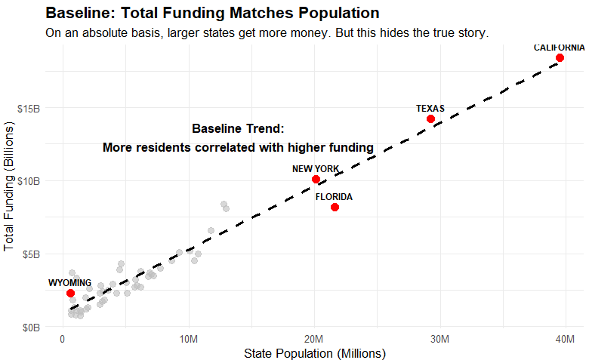
Illusion of Total Funding : appears equitable by population
Notes:
A scatter plot with a linear line was used to evaluate correlation and show the proportional relationship between raw population and total funding before normalizing by population
start with the baseline. If we only look at absolute dollars, the allocation actually looks perfectly fair. As you can see by the red highlight points, massive states like California and Texas get the biggest checks, while a small state like Wyoming gets much less. The trendline clearly shows that more residents equal higher total funding.
However, as we'll see on the next slide, absolute dollars completely hide the true story of individual, per-resident impact.

Slide 4
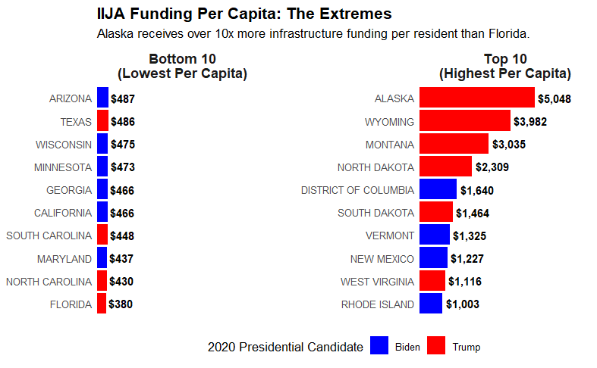
Reality: Infrastructure allocation heavily favors low-density states
• Extreme Disparity
• Geographic Factor
Notes:
A faceted horizontal bar charts used to rank and compare the extreme ends of the distribution. Horizontal orientation prevents label clipping, and data labels eliminate the need to trace values back to an axis
When I calculate the funding per capita, the reality flips. The allocation heavily favors low-density states.
This creates an extreme disparity: Alaska is receiving over $5,000 per resident, while highly populated states like Florida and California are receiving under $500 per resident. This is driven by a 'Geographic Factor'—building highway networks across massive, empty land areas requires disproportionately high spending per resident compared to dense urban centers.

Slide 5
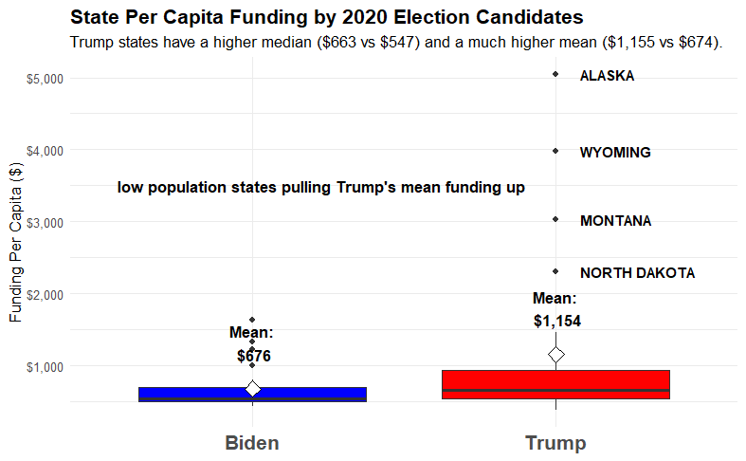
Political Bias: Allocation financially favors Trump-won states.
• The Median Advantage
• The Outlier Pull
Notes:
A grouped box plot with mean diamonds used to present distribution spread, medians, and skewness across both political candidates while also isolating extreme outliers at the same time
So, how does this geographic factor impact political bias? Because we used our Red and Blue Amity framework, the answer is immediately obvious.
The typical Trump-won state has a 'Median Advantage', receiving $663 per resident compared to just $547 for a Biden state. But look at the 'Outlier Pull' on the right. Those massive, low-population rural states we just talked about—like Alaska, Wyoming, and Montana—all voted for Trump. They pull the Trump average way up to $1,155, nearly double the Biden average of $674.

Slide 6
Geographic infrastructure formulas benefit conservative-leaning rural populations.
1. Is the allocation equitable based on population
NO, not population-equitable. Low-population bias.
2. Does the allocation favor the political interests of the Biden administration?
  NO, no Biden bias. Trump-won states receive $116+ more at median and almost double at mean.
Notes:
To answer these questions, # one: Is the allocation equitable based on population? No. It has a heavy low-population bias.
Number two: Does it favor the Biden administration? Absolutely not. Because the infrastructure formulas inherently benefit vast rural areas, the allocation structurally favors conservative-leaning states, resulting in much higher median and mean funding for Trump-won states.
Thank you, and I’d be happy to take any questions

